Slide 1
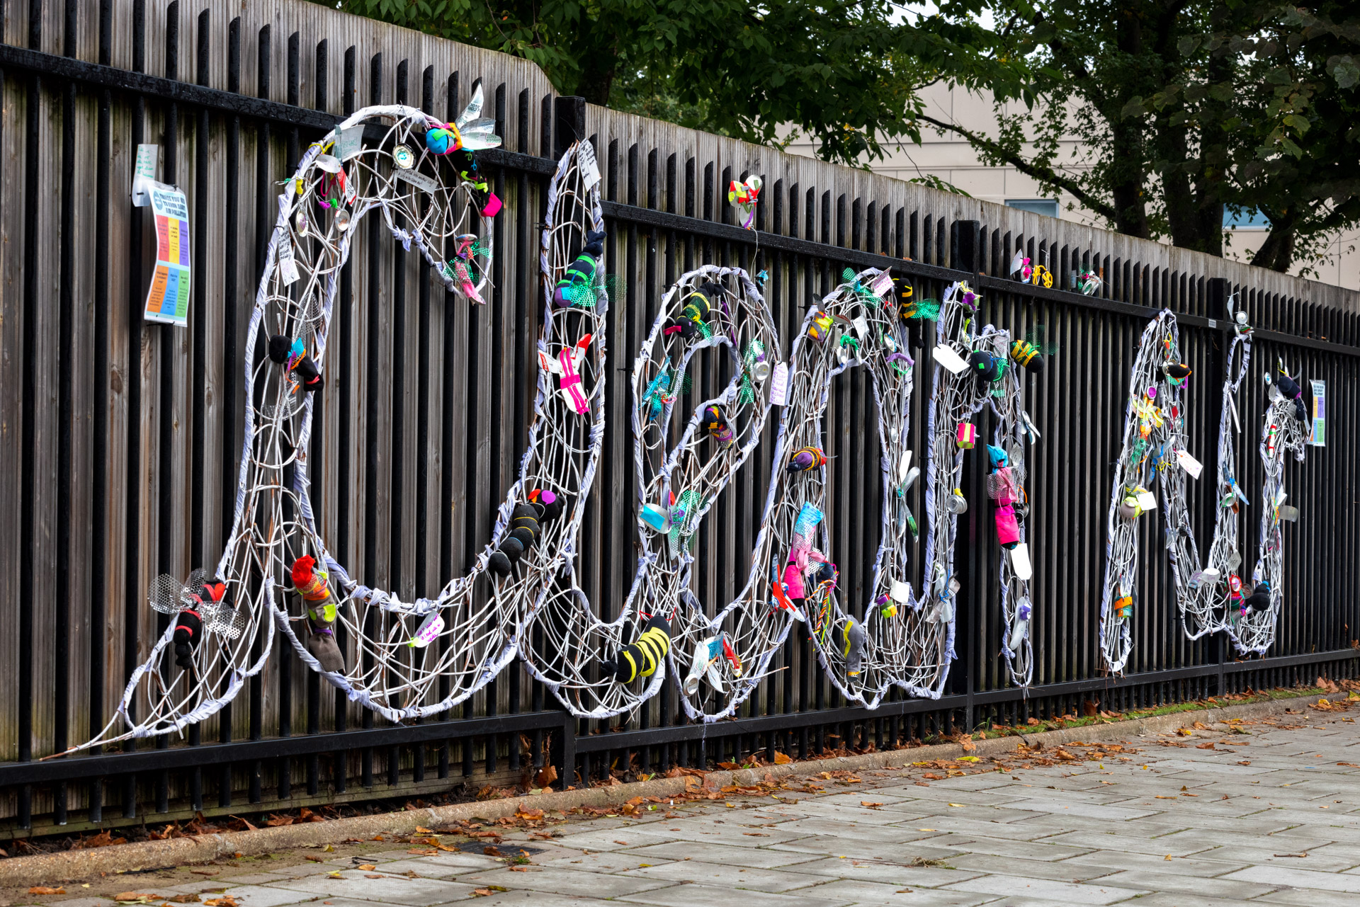
Image :Crispin Hughes
What is air pollution and
how can we protect ourselves?

Slide 2
What do we use our lungs for?
Notes:
Give the group 1 minute to whisper ideas/ share with partner/ jot on a whiteboard – ask for ideas

Slide 3
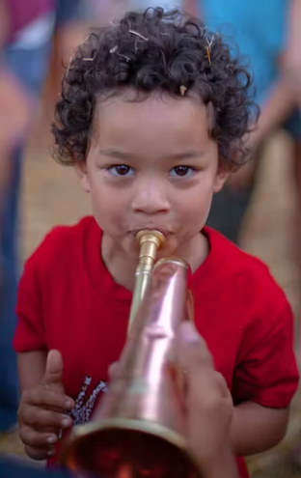
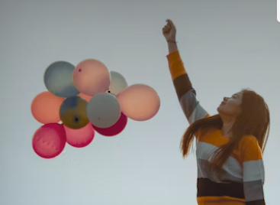
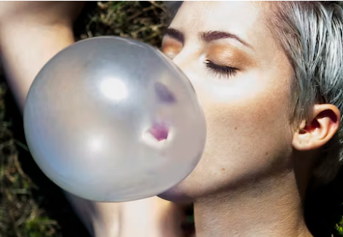
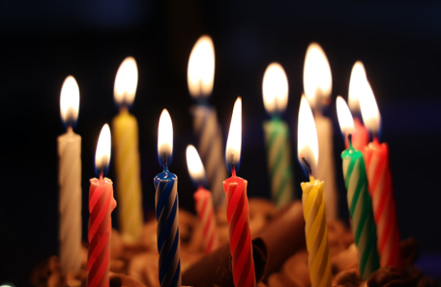
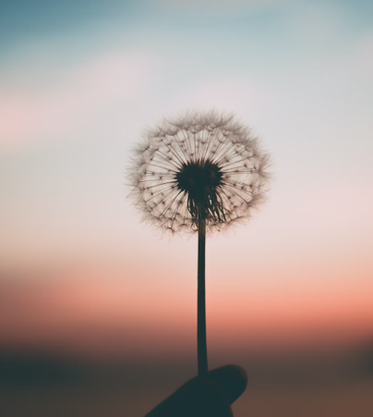
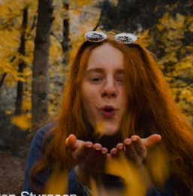
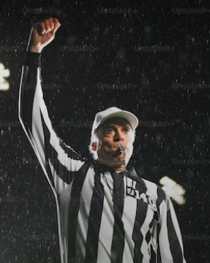
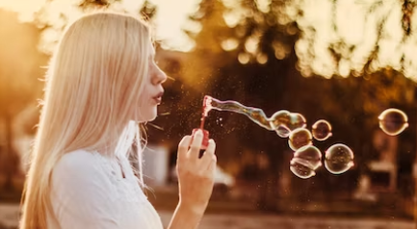
Notes:
Show the group the bugle – ask someone to have a go – it’s hard isn’t it!!

Slide 4
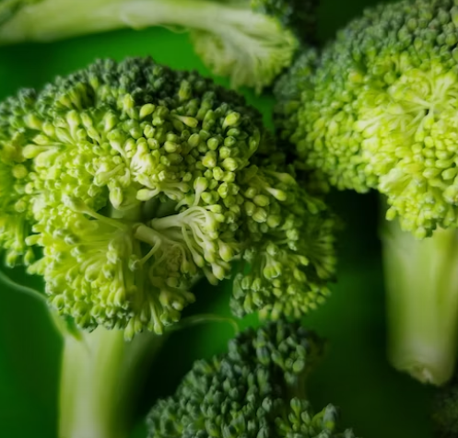
What do our lungs do?
They are one of our biggest organs
Our lungs contain alveoli
Notes:
Your lungs are one of your biggest organs. When we breathe the oxygen passes into our lungs into our alveoli – it looks a bit like broccoli!
From there the oxygen passes through our lung walls and gets transported around our body. We then breathe out the waste product carbon dioxide
Did you know that if you spread out the surface of your alveoli you could cover an entire tennis court!

Slide 5
How many times do we breathe in a minute?
Notes:
Tell your partner how many times you think we breathe in a minute – if you have time you could time a minute and get the group to count their breaths

Slide 6
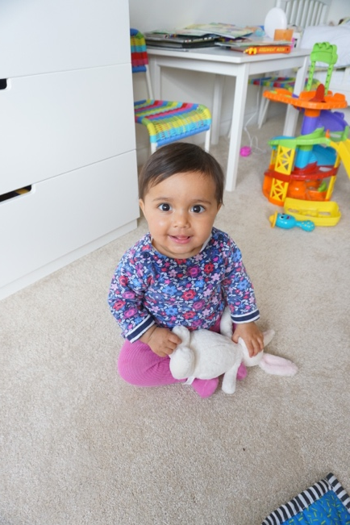
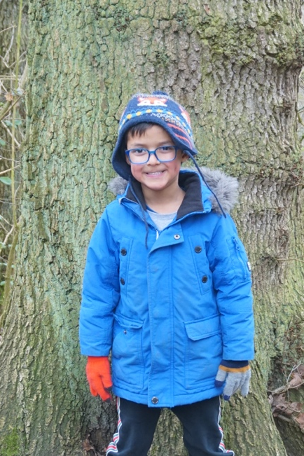
Who takes the most breaths per minute?
1 – 2 year old
2 - 5 year old
5 -12 year old
Notes:
Get the group to discuss who takes the most breaths – they can guess how many and the reason why – size
1-2 yr old = 30-35 2-5yr old 25 -30 5-12 yr old 20-25 adult at rest around 15

Slide 7
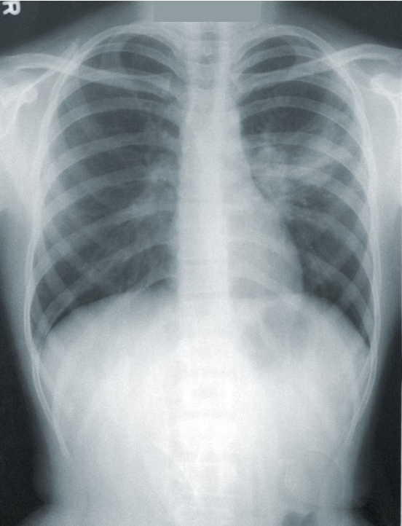
Love our lungs
Did you know that our lungs grow until we are 18?
Notes:
I’m here today to encourage you to love your lungs – they’re amazing
Our lungs start growing when we are just a tiny baby still in our mother’s tummy. They then continue to grow and develop up until we’re 18

Slide 8
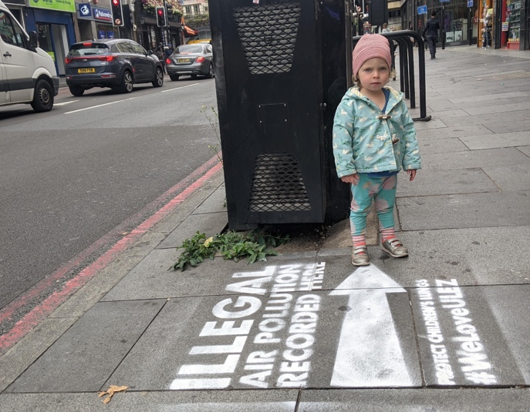
What is air pollution?
Nitrogen dioxide (NO2)
Mostly created by transport
Particulate matter (PM2.5 / PM10)
Microscopic particles like soot and dust that we breathe in
Notes:
So if our lungs are still developing and if we take more breaths than grown-ups its really important that we breathe clean air
I’m here today to tell you a bit about air pollution and what we can all do to protect ourselves
PM = put very simply these are microscopic solids (dust and soot) that can pass through your lungs into your bloodstream, roughly 30x smaller than the width of a human hair
In the past – from coal burning but now traffic emissions and domestic and commercial burning
Manchester – 31% increase in cars 17% PM emissions from domestic burning

Slide 9
What creates air pollution?
Look at the pictures
Which is the most polluting?
Which is the least polluting?
Notes:
Give students set of images – ask them to:
Number them most to least important.
Cut them out and order them
Choose the one you want to tell your partner about/ group to tell the class about – why does this create air pollution – is it a good way to travel etc
All of the above dependent on time available

Slide 10
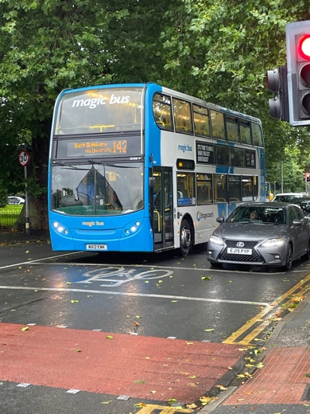
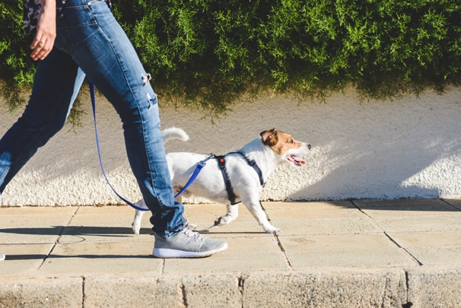
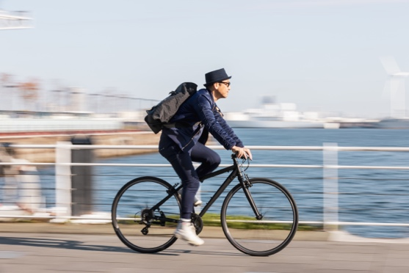
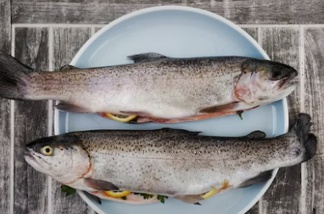
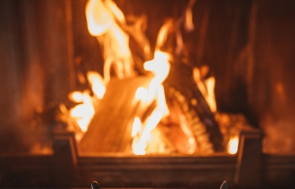
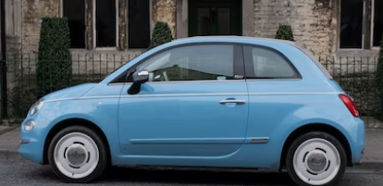
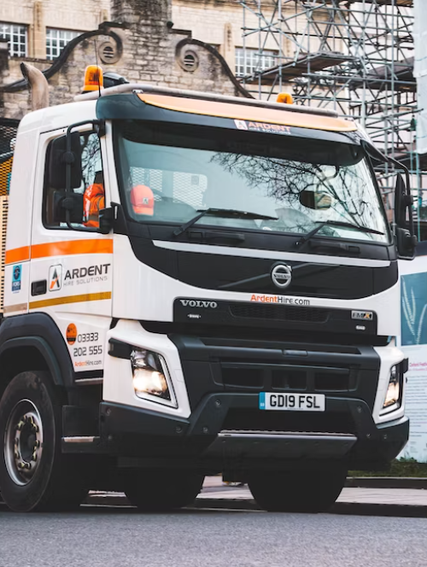
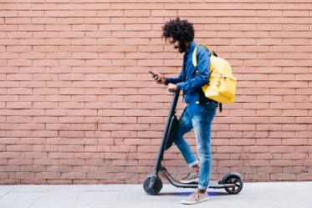
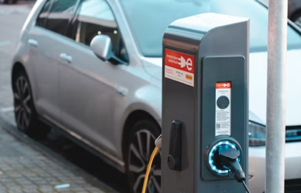
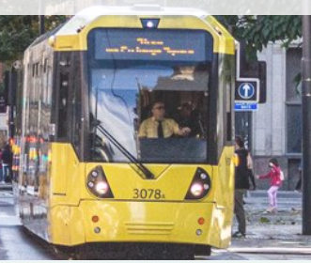
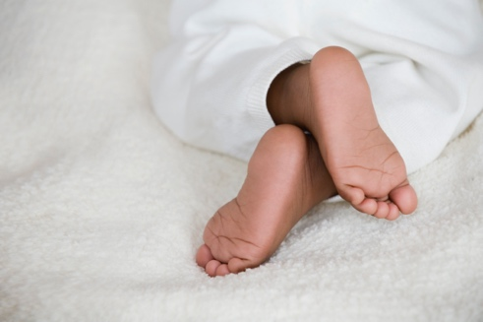

Slide 11
What can we do?
Notes:
Ask the children for their suggestions first – they should come up with different modes of transport from previous activity

Slide 12
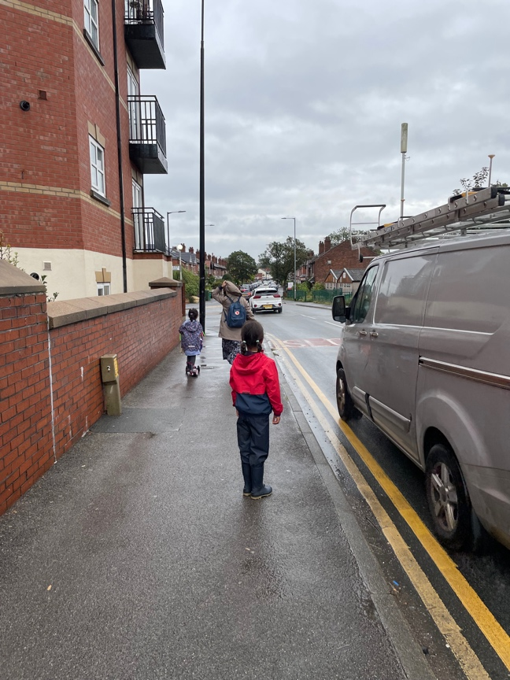
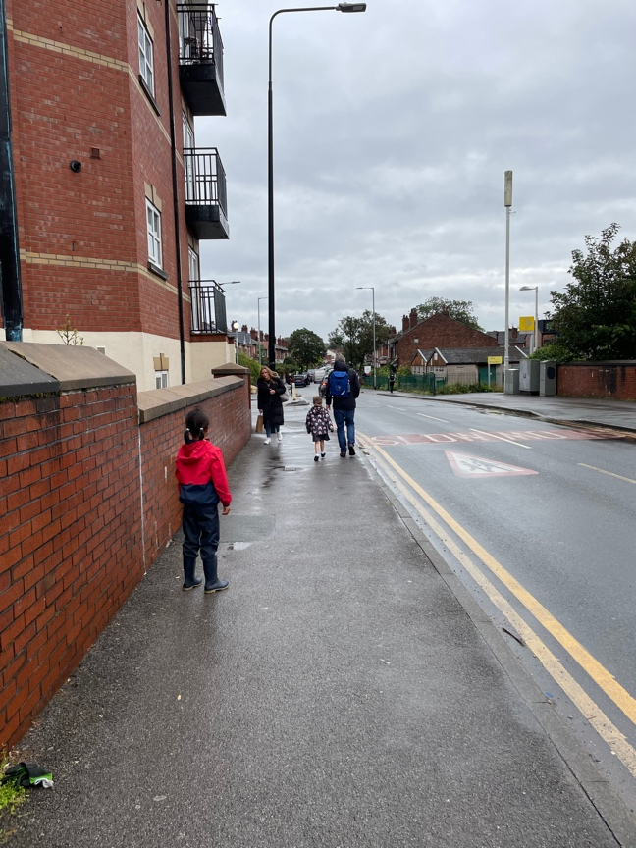
What can we do?
Notes:
We can walk to school – this is a girl in her wellies and waterproofs having a great time splashing in puddles. Walking is great for our brains and gets us ready to start our learning when we get to school.
Where we can, we can try and walk down less busy routes
Look at the two pictures, what do you notice about where the girl in red is stood?
Which is a better place to walk – do you know why? Explain that walking away from the kerb can reduce your intake of air pollution by up to a 1/3

Slide 13
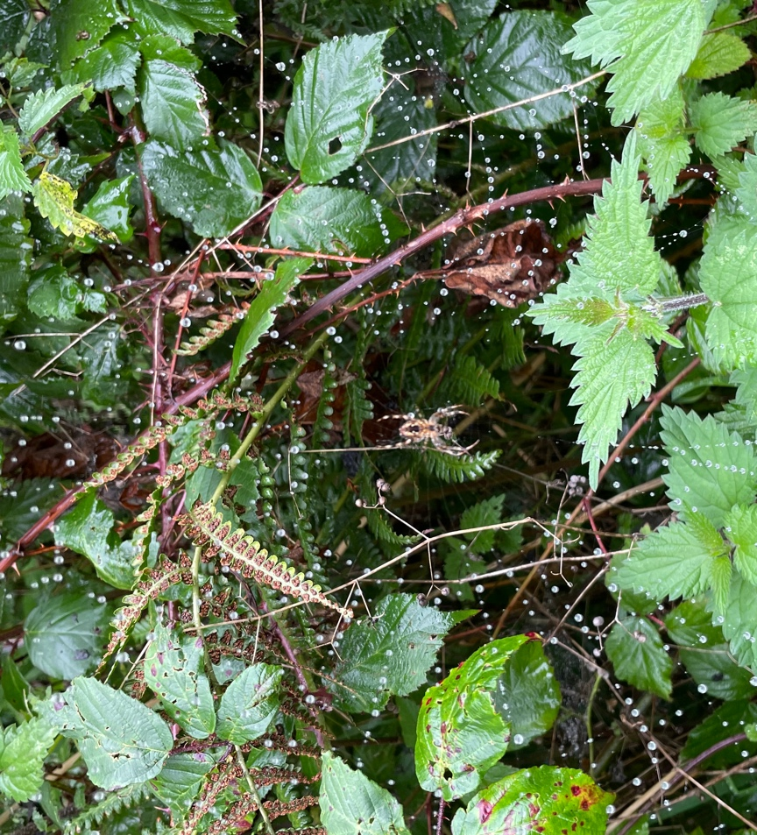
What can we do?
Try to find less busy routes away from the main roads.
You never know what you might see!

Slide 14
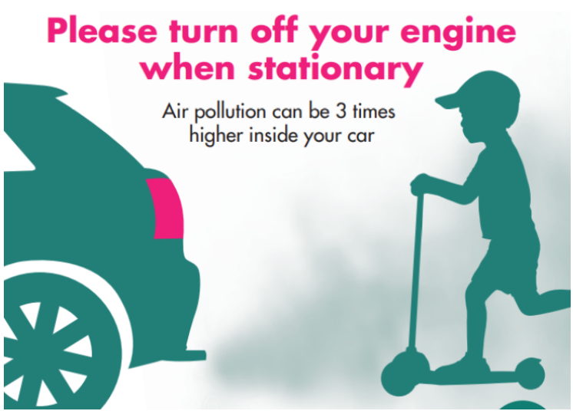
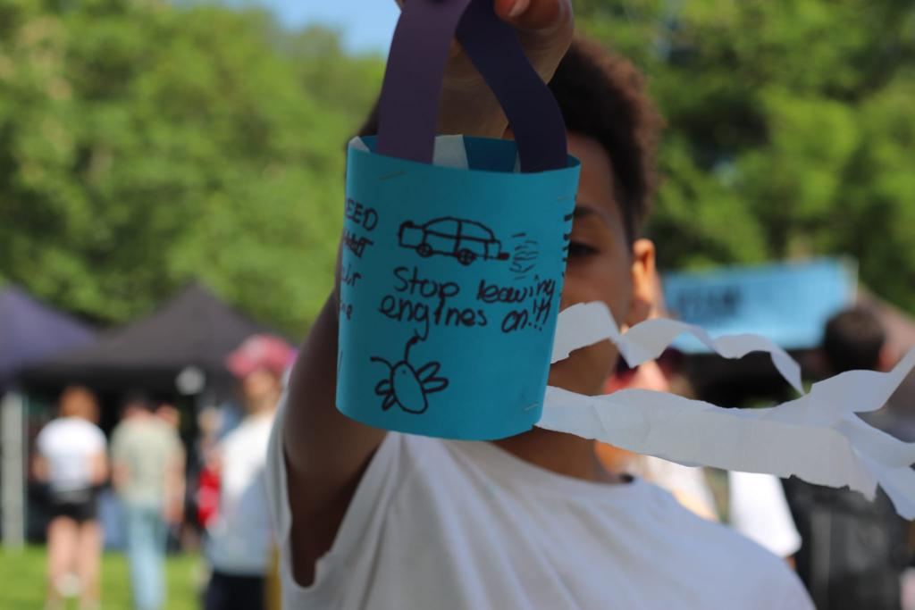
What can we do?
Ask your grown up to turn off the engine when you’re parked
Image :Sarah Pull
Notes:
If your grown up has to drive, try to park further away from the school and turn off your engine.

Slide 15
What can we do?
We can try to walk, scoot or cycle
We can try to catch a bus, a train or a tram
Notes:
This is a tricky one as you’re not often in charge at home but you can ask – maybe if you’re ready a bit earlier for school you can walk or scoot in

Slide 16
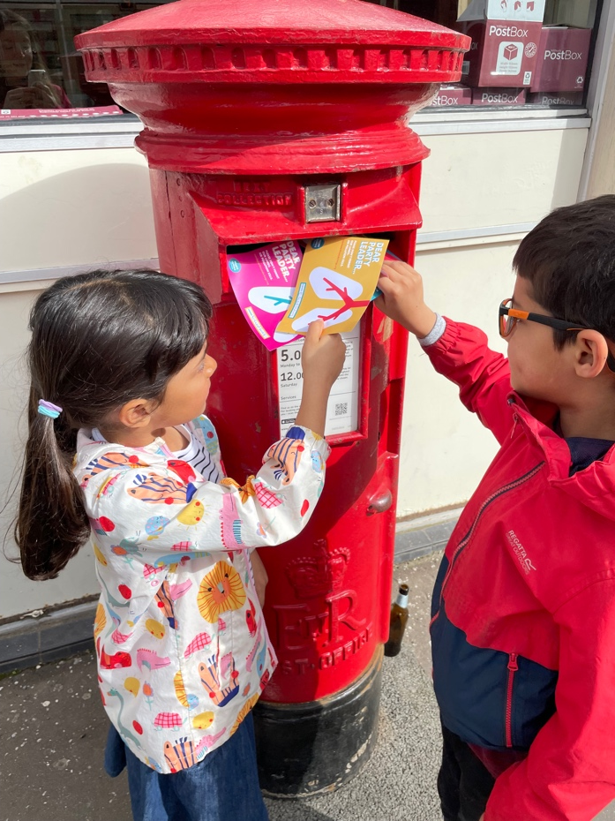
What can we do?
Be a changemaker!
Tell someone about today – you have the power to change minds!
You could write a letter or draw a picture and send it to an MP or someone else who is important
Notes:
You have so much power – you can change people’s minds simply by telling them about what you’ve learnt today. That lungs are amazing, that our lungs keep growing until we’re 18 , that we need to breathe clean air to keep us healthy
If appropriate – talk about School Streets and raising awareness in assemblies etc

Slide 17
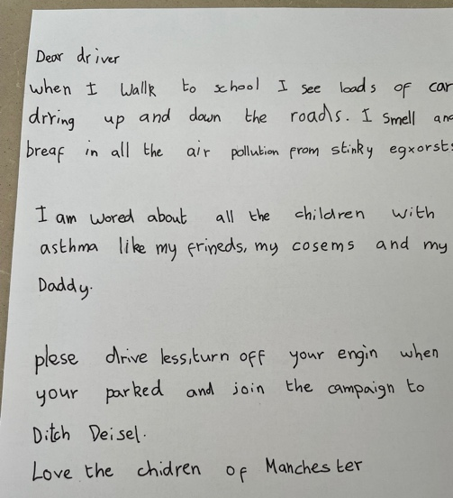
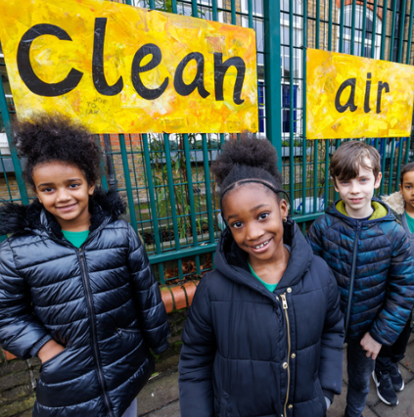
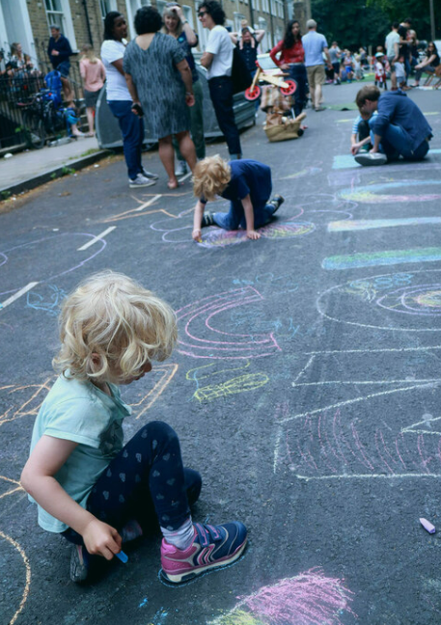
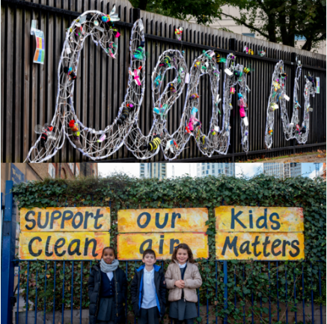
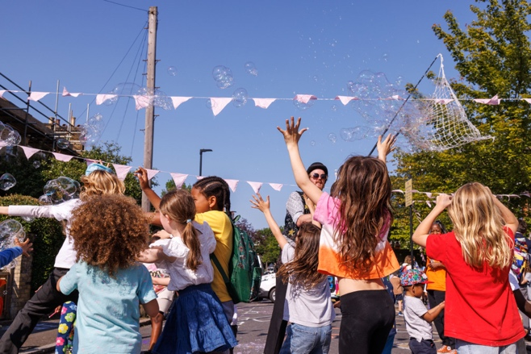
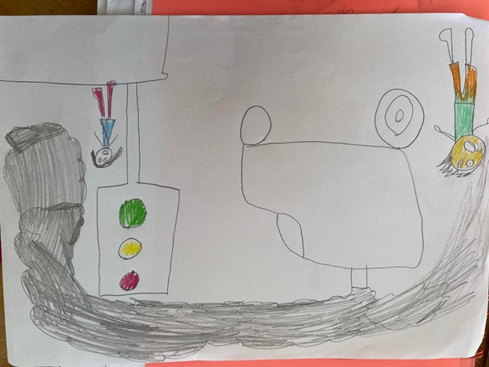
Images :Crispin Hughes, Joe Twigg, Ellen Foster Price

Slide 18
Please get in touch for support
or advice at
hello@mumsforlungs.org
www.mumsforlungs.org | Social media: @mumsforlungs

