Slide 1
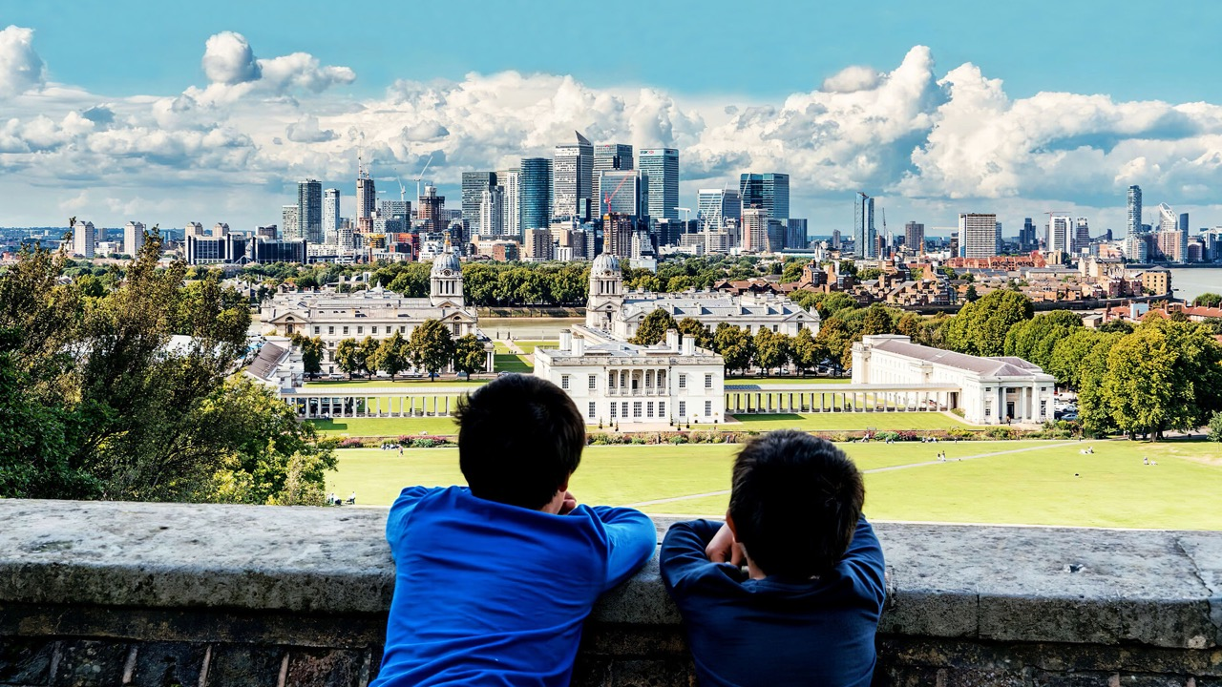
Notes:
Holding slide for the start of the assembly, as people come in.

Slide 2
Notes:
Introduce yourself. (Hi I’m xxx, I live here in xxx and I have xxx children, and my favourite colour is xxx (something personal to break the ice!).
(If you’re doing this as part of or on behalf of Mums for Lungs, here’s a suggested sentence to say:
I volunteer with a group called Mums for Lungs. We’re a group of mums, dads, grandparents and children who are worried about air pollution).
I’m here to talk with you about the air that we all breathe, and why it’s so important.

Slide 3
Notes:
OK, so do you know what actually happens when you breathe? Because it’s something that just happens without us even thinking about it, isn’t it?
When we breathe in, we take in the air from around us, into our lungs and every cell of our body.
Our body needs the oxygen in the air to help create energy, and that energy fuels everything our bodies can do.
From moving and growing to digesting.

Slide 4
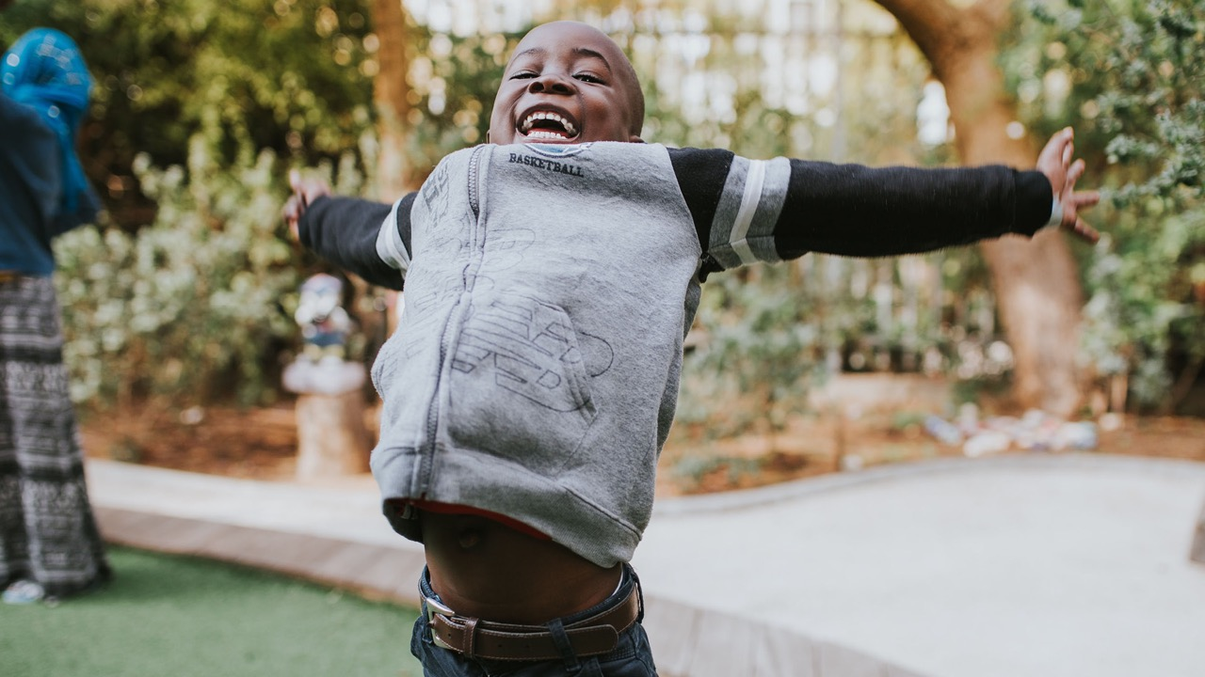
Notes:
So now you know why breathing is so important, maybe we should practice, and make sure we’re doing it right. We’re going to take three deep breaths in together… in through your nose, lungs, belly and out through your mouth. 1, 2, 3. Well done!
Did you know that children actually breathe in more air than adults - an adult takes 12-18 breaths a minute, and a 3-year-old takes 20-30*. That’s because children’s lungs are smaller than adults, and so they have to breathe more, and faster, to take in the right amount of air.
It’s one of the reasons clean air is so important for children.
Another is because your lungs are growing and dirty air makes it harder for them to grow big enough.
*https://www.unicef.org/rosa/stories/toxic-air-harming-our-children-every-breath-they-take

Slide 5
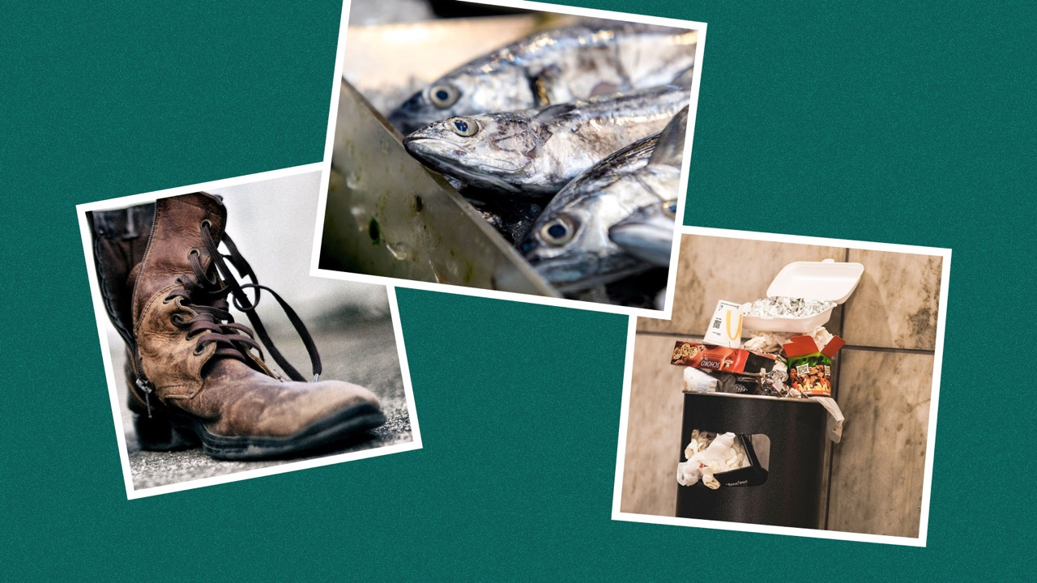
Notes:
Now I need you to do some work for me - please can you put your hands up and tell me what you can see here?
[You want them to say boot, fish, rubbish]
And what do they all have in common?
[You’re aiming for them to say that they’re all smelly things - steer them towards this if necessary!]

Slide 6
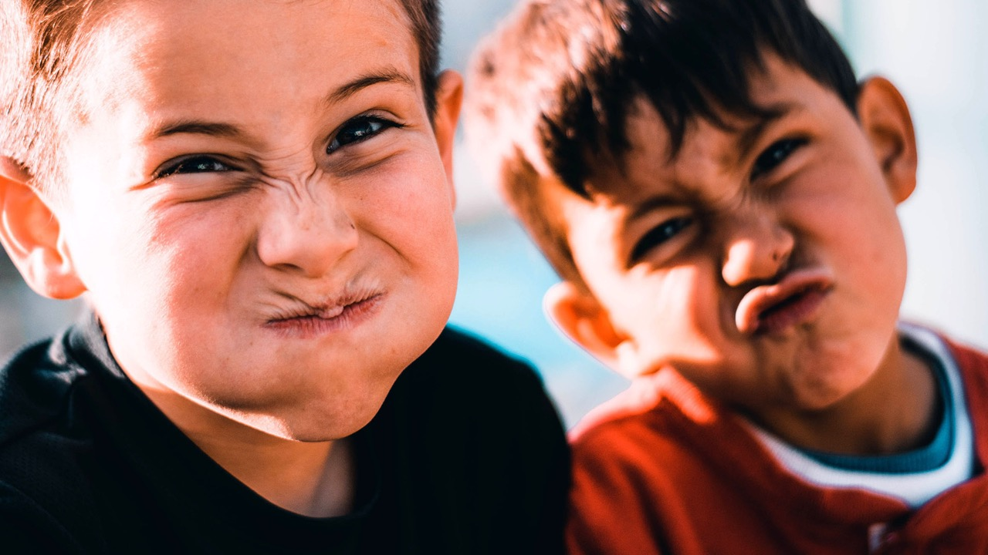
Notes:
Luckily not everything that smells bad is bad for you!
Smelly feet might not be nice, but they’re not bad for you.
Smelly fish and rubbish might be horrible, but won’t hurt you.
But some things with a bad smell ARE bad for your health.

Slide 7
Notes:
Your turn again - please put your hands up and tell me what things are in these pictures.
[You want them to say cars, fire, lorry]
So these are things that have a bad smell, AND they are bad for your health.
The smell from cars and burning wood is bad for us. It contains pollution, which is gases and tiny little bits of dust that get into our body when we breathe, which can make us sick – they can make us cough or have headaches.
We need the air to be clean, otherwise, the dirty stuff travels into our bodies. And that is not good for anyone, to have dirty air and bits of dust in their body.

Slide 8
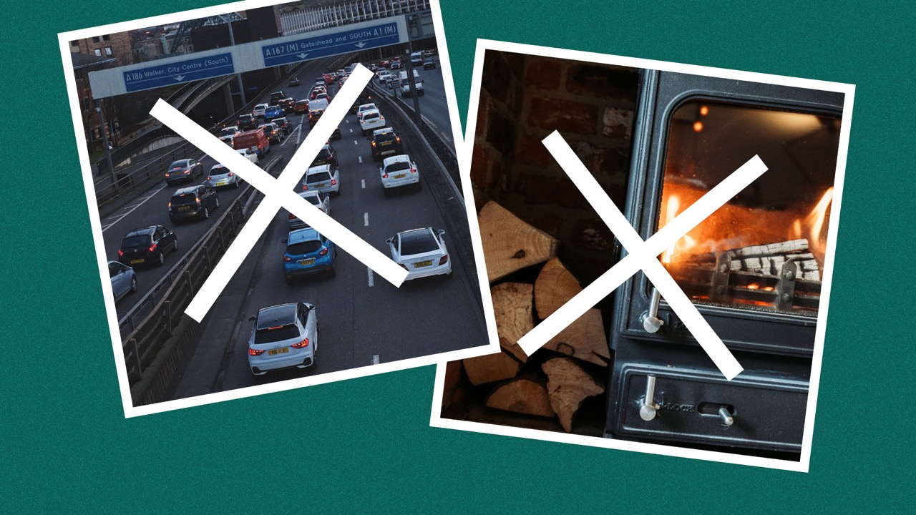
Notes:
What can we do to avoid having so much pollution? There are two big things:
Stop driving so much, and
Stop burning wood.
[Question you can ask older years: Do you think driving an electric car means there is no pollution?
Answer you want / or can steer towards: No! Electric cars may not give off gas from the petrol, but they still create tiny bits of dust and particles from the brakes and the tyres].

Slide 9
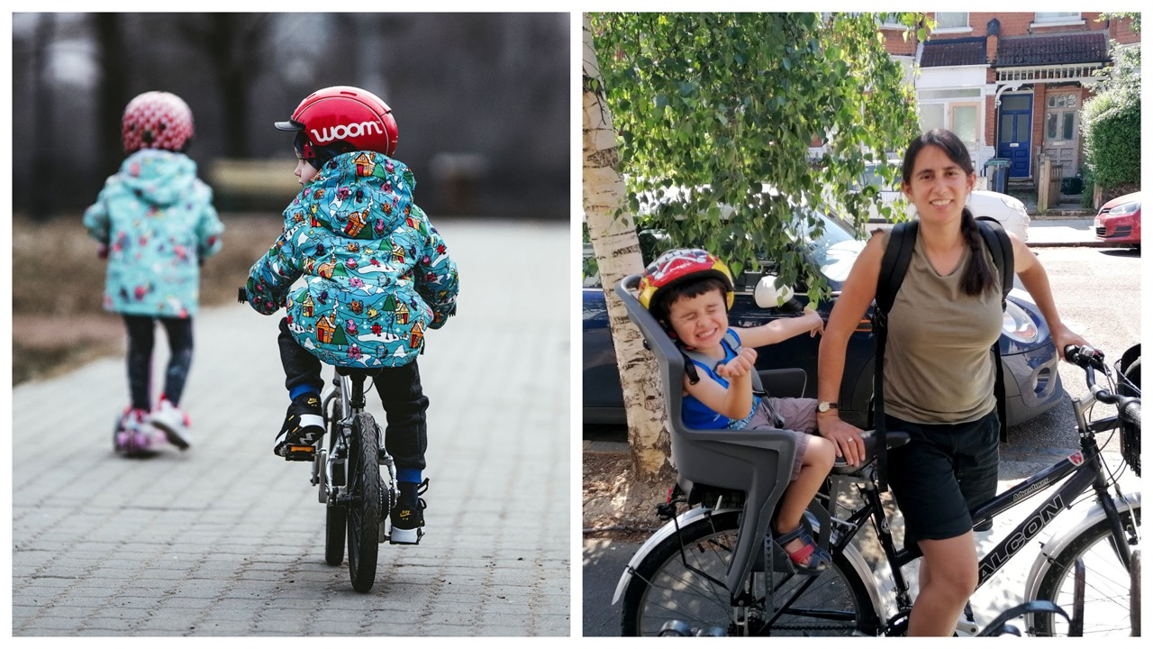
Notes:
Instead of driving, you could cycle or scoot or wheel instead, if you can! It’s more fun, and much better for your health.

Slide 10
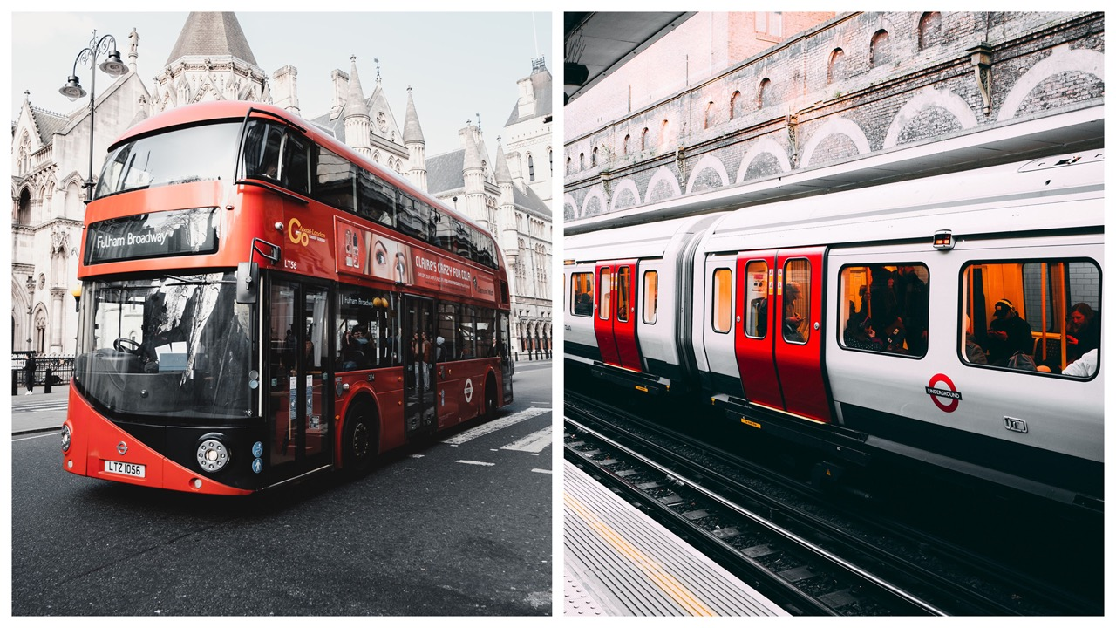
Notes:
Or take public transport…
[Question you can ask older years: Why do you think taking public transport is better than driving?
Answer you want/or can steer towards: More people can travel in one bus or train than one car, so if lots of people use buses and trains there will be fewer cars on the road. Therefore there is less pollution, even though buses and trains still create pollution.]

Slide 11
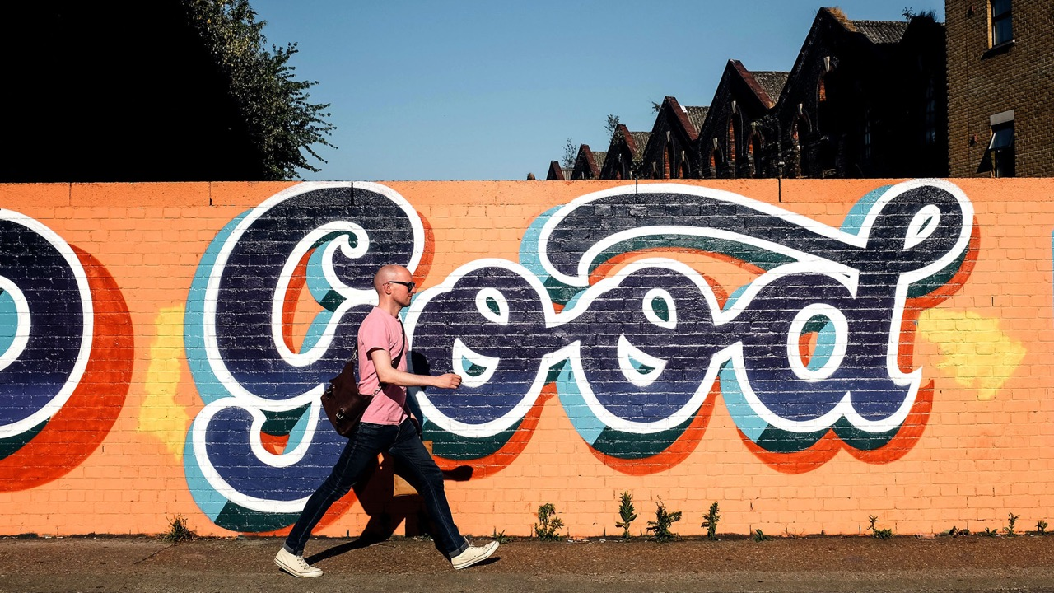
Notes:
Walking is also great, if you can!
Did you know that we need 200 muscles just to take one step? Even just walking for 10 minutes a day helps to keep us fit, healthy and active.

Slide 12
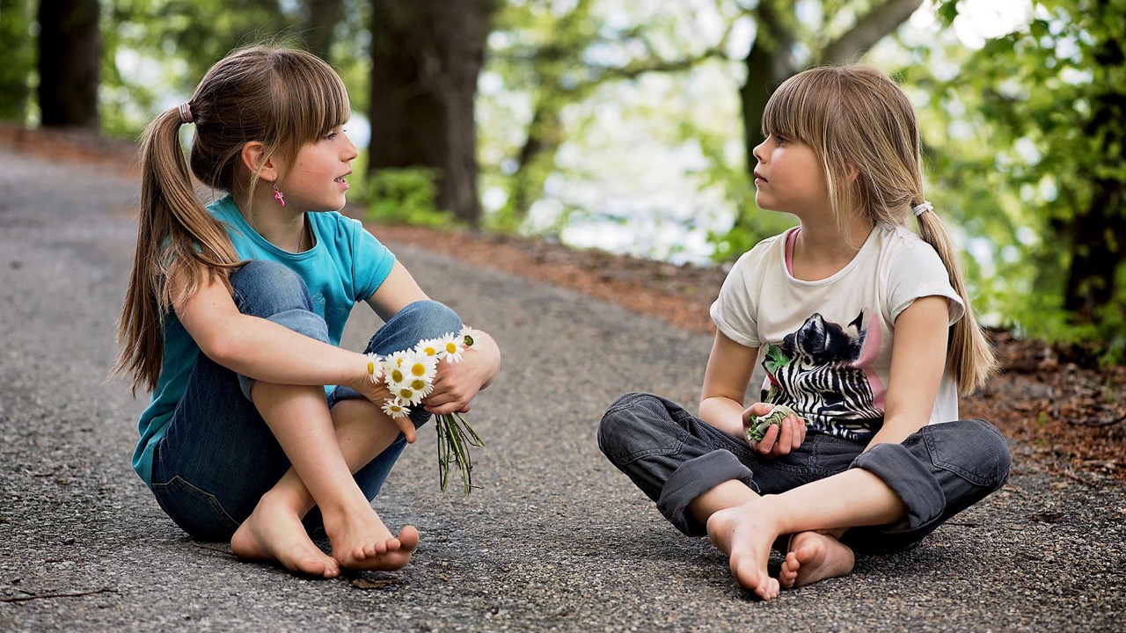
Notes:
What else can you do?
Talk to your friends about how important clean air is, and how to stay away from dirty air.
Be a changemaker - tell someone about today – you have the power to change minds!
You could also draw a picture or ask someone to help you write a letter and send it to your MP or someone else who is important

Slide 13
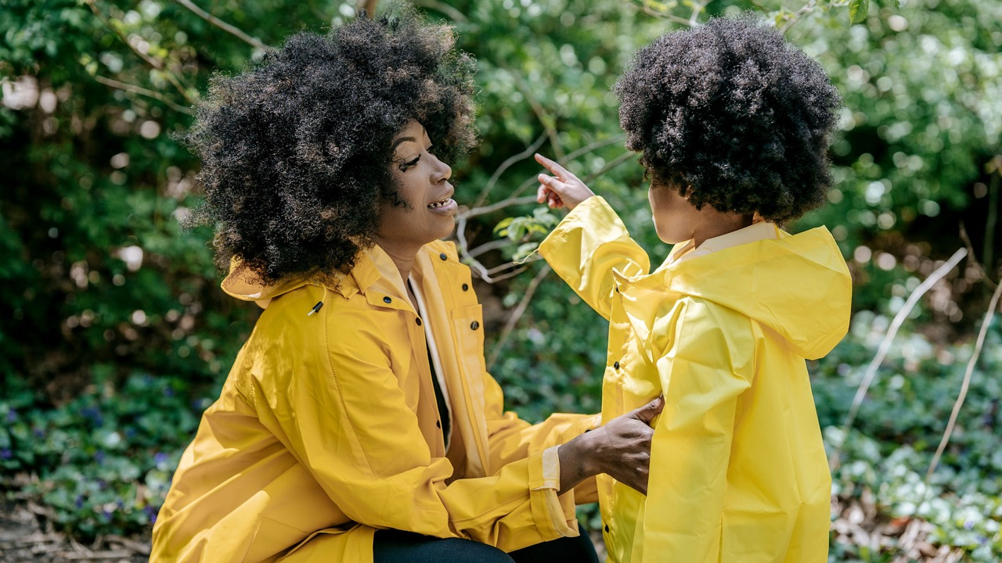
Notes:
And make sure your parents know too.
Make sure they know it’s better to walk, scoot, cycle or wheel (if they can) than to drive, and that there is more pollution inside a car than outside it**.
And make sure they know that burning wood is bad for your health.
**[this depends on the traffic in front of the car, but it can be 9-12 times higher, because the fumes from the vehicles in front can come into the car and get trapped there.]

Slide 14
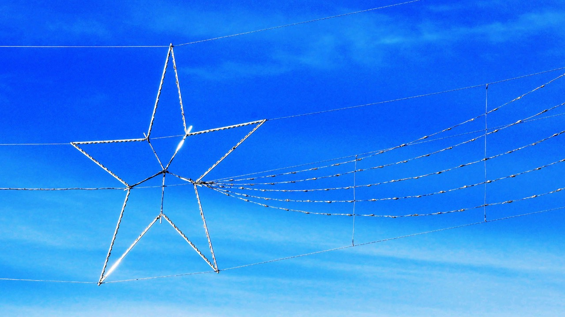
Notes:
Thank you so much, that’s the end of today’s talk. Do you have any questions?
[Or there may not be time for questions - check with teachers in advance].

